Slide 1
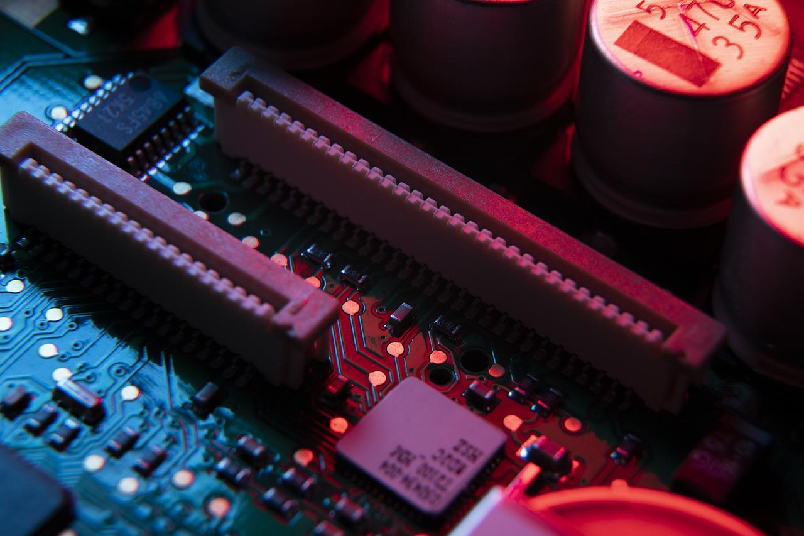
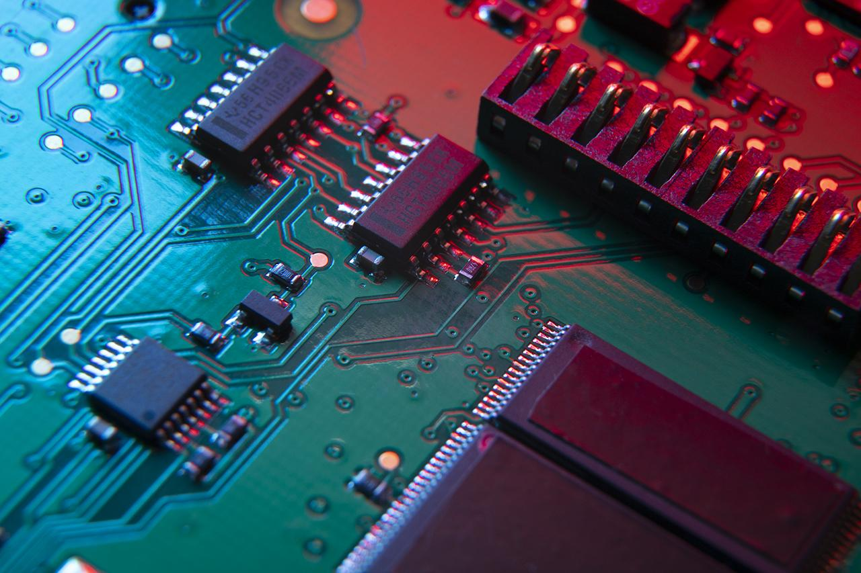
BCD To 7 SEGMENT
01
03
02
Name :Yadav Rohit
Branch : CE
Name :Yadav Rohit
Branch : CE
Name :Yadav Rohit
Branch : CE
05
04
Name :Yadav Rohit
Branch : CE
Name :Yadav Rohit
Branch : CE
0 1 1 1 ----- > 7

Slide 2
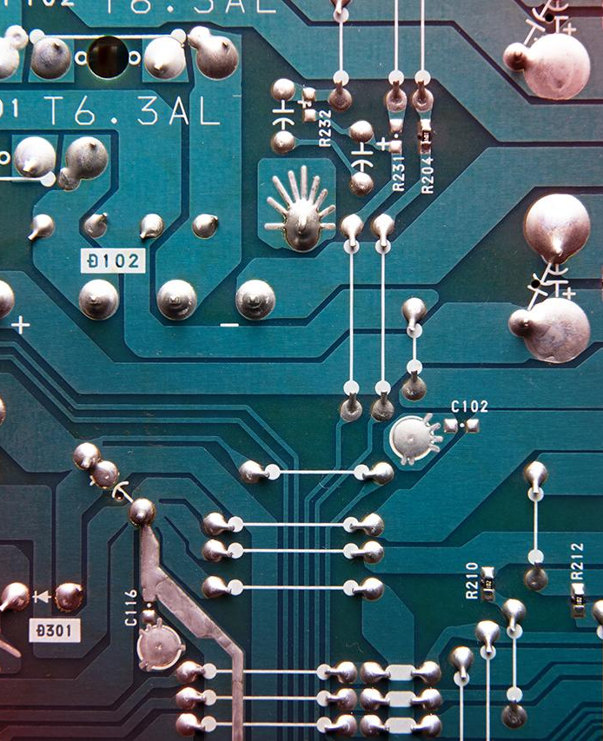
Team
01
02
Name :Yadav Rohit
Branch : CE
Name :Yadav Rohit
Branch : CE
03
04
Name :Yadav Rohit
Branch : CE
Name :Yadav Rohit
Branch : CE
05
Name :Yadav Rohit
Branch : CE

Slide 3
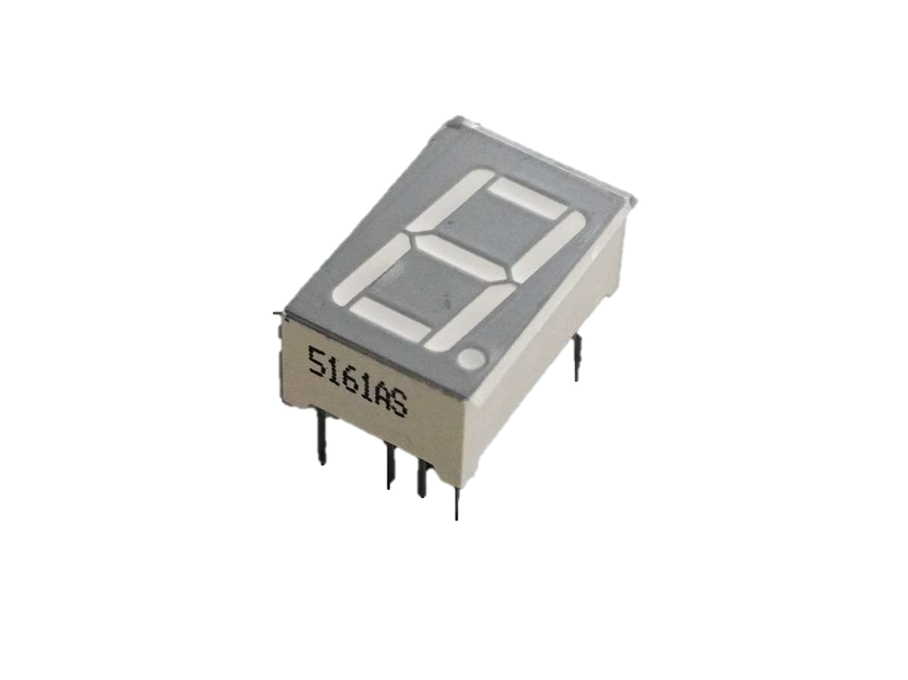
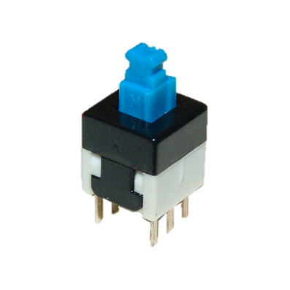
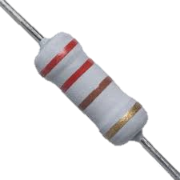
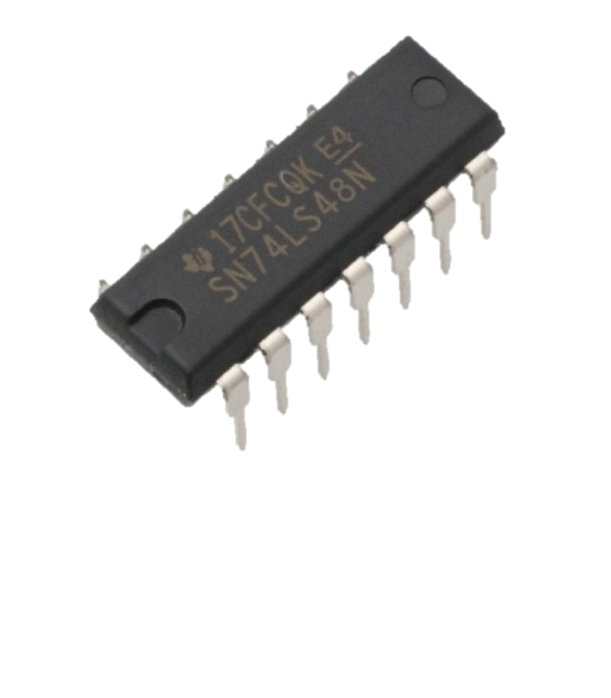
Introduction
Our project, The BCD to 7 Segment Converter, is to bridge the gap between these two formats.
We aim to create a circuit that can take BCD input and display the corresponding decimal digits on a 7 segment display.
This conversion is essential for various applications in digital electronics, such as digital clocks, calculators, and electronic meters.
04
01
Resistors
IC 7448
03
Etc.
02
Swithches
7 segment Display

Slide 4
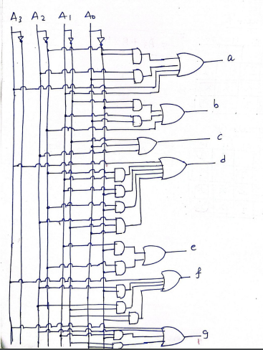
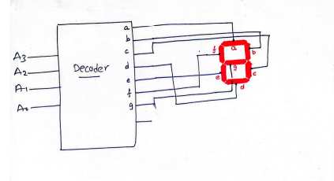
Components
02
04
01
03
Swithches
Resistors
IC 7448
7 segment Display
Etc.

Slide 5
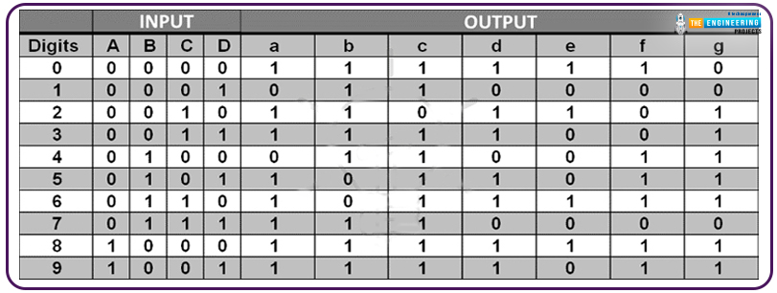
Circuit Diagram

Slide 6
Truth Table
Applications
Counters and Timer
Digital Clocks
Calculator
Instrumentation
Medical Devices
Consumer Elc.

Slide 7

Applications
Digital Clocks
Calculator
Counters and Timer
Instrumentation
Consumer Elc.
Medical Devices

Slide 8
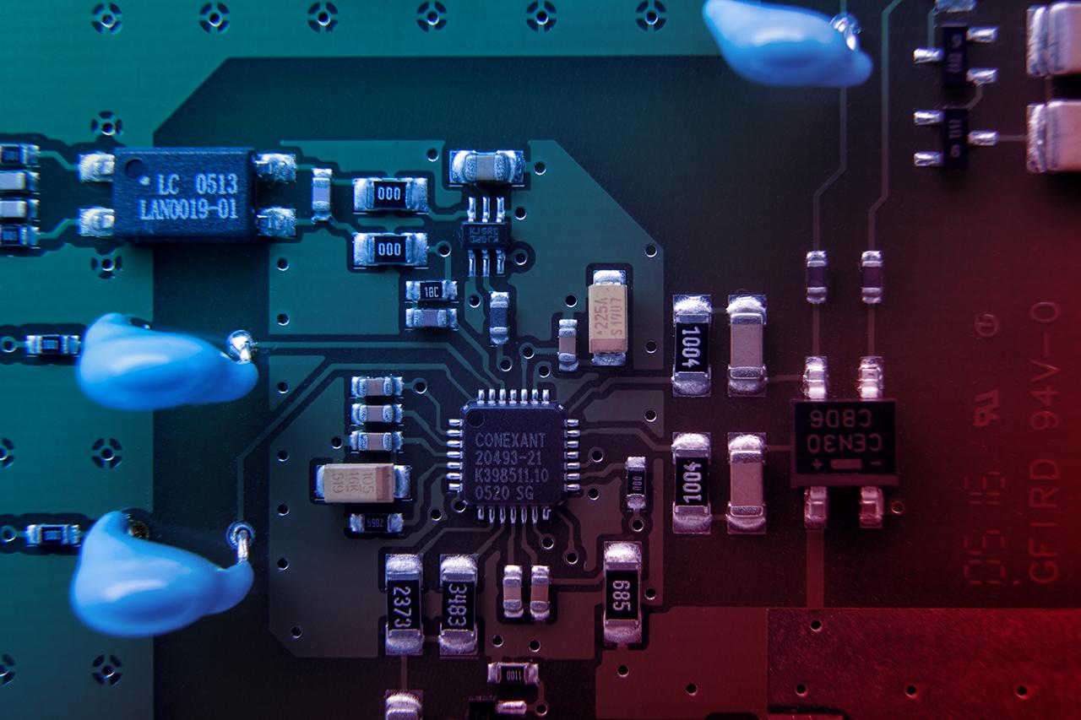
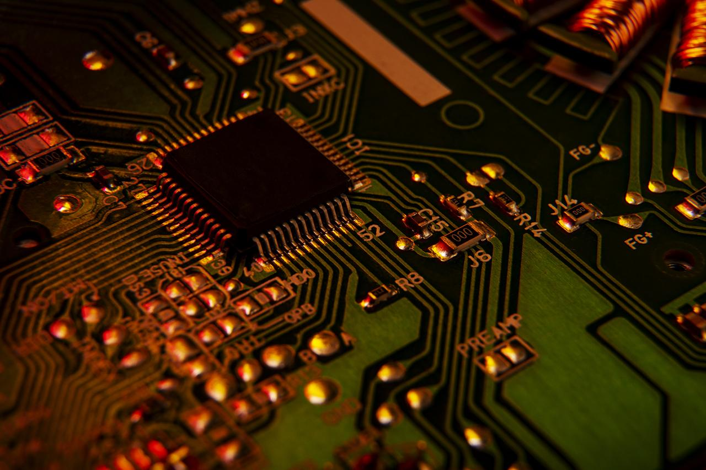
Working Video

Slide 9
Thanks

